Slide 1

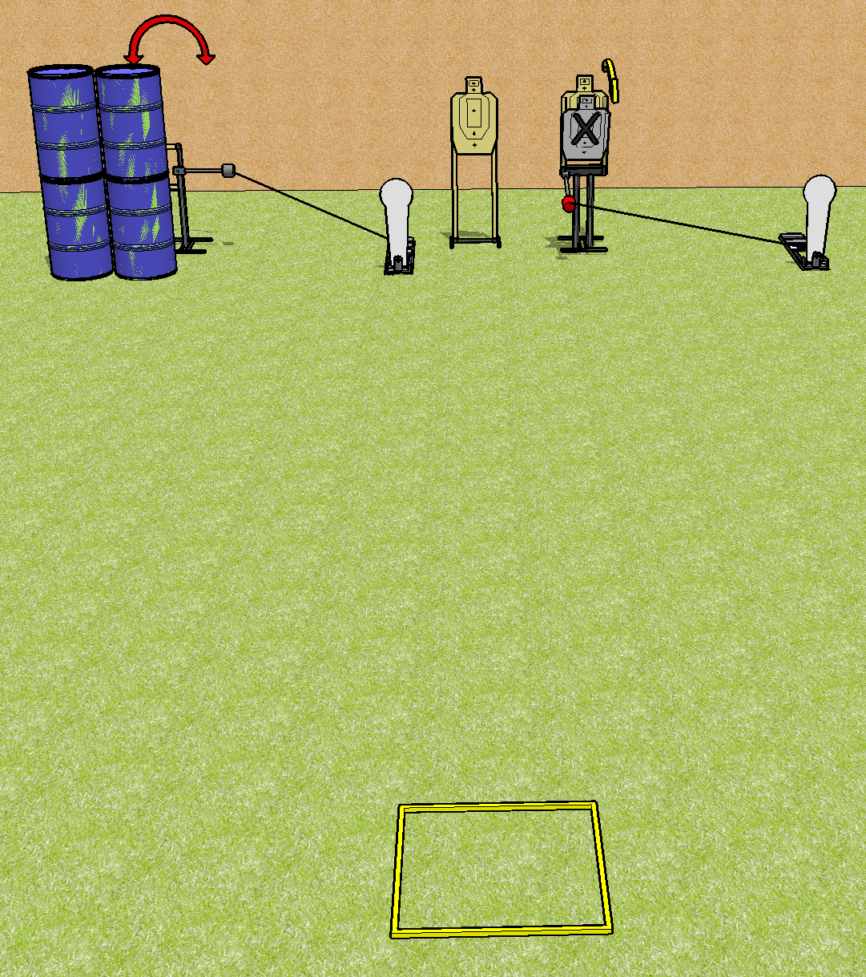
 | Dothan Practical Shooters – USPSA Match Speed and Power Course Designer : Drew Coleman Bay: B4
Round Count 8 rounds 3 USPSA 2 colt poppers
Equipment List Swinger + activator Max trap + activator Shooting box 4 targets (3 + 1NS)

Slide 2
Speed and Power
Written Stage Briefing
Scoring: Comstock Rounds: 8
Targets: 3 USPSA, 2 steel
Handgun start position: anywhere inside the shooting area, facing up range, wrists above shoulders.
PCC start position: anywhere inside the shooting area, stock on belt. Loaded carbine is held with both hands, safety on.
Stage Procedure: on the audible start signal, engage targets as they become available from within the shooting area. T1 is activated by P1 and remains visible at rest. T3 is activated by P2 and remains visible at rest.

